Slide 1
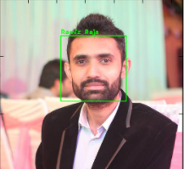
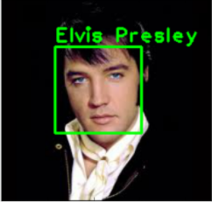
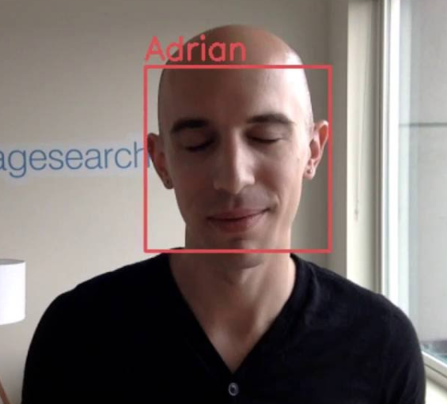
Facial Recognition using Open CV and Python

Slide 2
What is facial recognition?
A computer application.
Able to identify and verify persons from a digital image or video.
Used one of facial features (ex: Haar-like-feature) from the image and compare to the face database.
Contains 2 major stages: training and detection.
+ Training Stage: to get sample of data of both negative and positive. (Negative sample means the image does not contain object, but positive does)
+ Detection Stage: describes what kind of object that camera see and is documented in Open CV documentation.

Slide 3
What is Haar-like-feature? How does it work?
Haar-like-feature: Classifiers is an effective object detection method proposed by Paul Viola and Michael Jones. The machine learns how to detect the object based on the number of positive and negative images to train the classifier, extract features from them and then determine the result.
How does it work?
+ Haar uses 3 kinds of feature to track the information in the image by subtracting sum of pixels under white rectangle from sum of pixels under black rectangle like below:

Slide 4


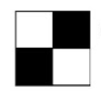
3 kinds of feature in Haar-like-feature
Edge feature:
Line feature:
Rectangular feature:

Slide 5
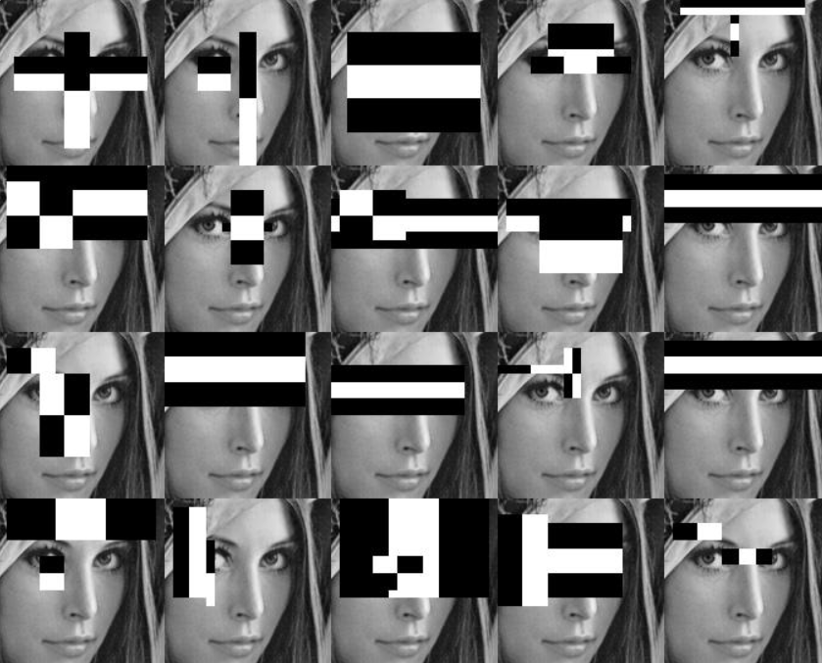
How does it work? (con’t)
It will calculate the plenty of features using all the sizes and locations of each kernel.
Then, its will find the sum of pixels under black and white rectangles for each feature calculation.
Most of features it calculates are not relevant.
The image shows that different regions have different features.
For example: eye contains line and rectangular feature, nose has line and edge feature, etc…

Slide 6
How does it work? (con’t)
Next, it gathers all of features together to train the images, and determine which one is positive and negative image.
Then, it selects the features with the minimum error rate that classifies the human face.
Finally, the image is determined by around 6000 features to get the higher percentage of accuracy. It means the image taken by camera will be applied 6000 features to check if it is a human face.

Slide 7



Materials for this project
Laptop or Desktop (Desktop must include a webcam)
Open CV 3.0 or above
Python 2.7 or 3.6

Slide 8
How to set up?
Go to the url:
http://opencv-python-tutroals.readthedocs.io/en/latest/py_tutorials/py_setup/py_setup_in_windows/py_setup_in_windows.html

Slide 9
About my project
This project includes 2 python files, one haar cascade xml file and a faces collection folder:
+ facetraining.py: This file lets the user train the face name by accessing webcam, taking about 30 pictures of the face and put it into the folder with the name that we want to train. It has the Haar Cascade feature to detect and take the picture of the face only.
+ facial_recognition.py: It uses the Haar Feature-based Cascade Classifiers to detect the face , compare the detected face with all the training faces in faces collection folder and check if it match with any of the pictures in that folder to determine whose faces are in front of the camera.
+ haarcascade_frontalface_default.xml: provided source code, you can download from this url: https://github.com/opencv/opencv/blob/master/data/haarcascades/haarcascade_frontalface_default.xml

Slide 10
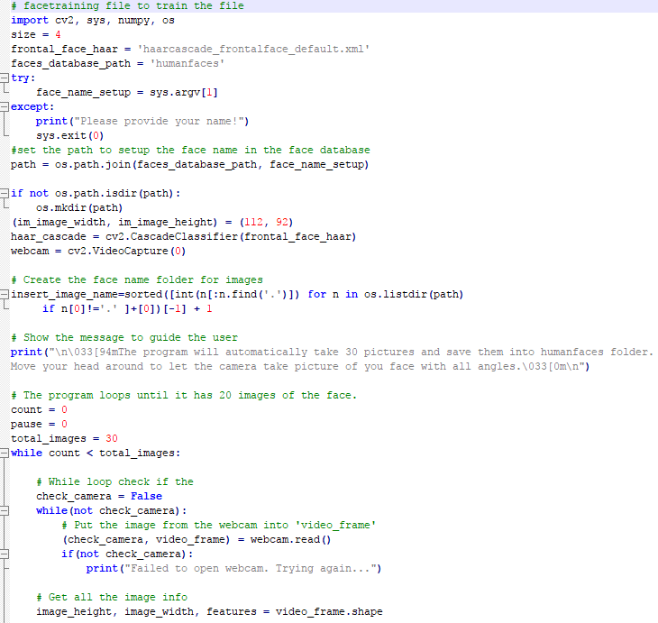
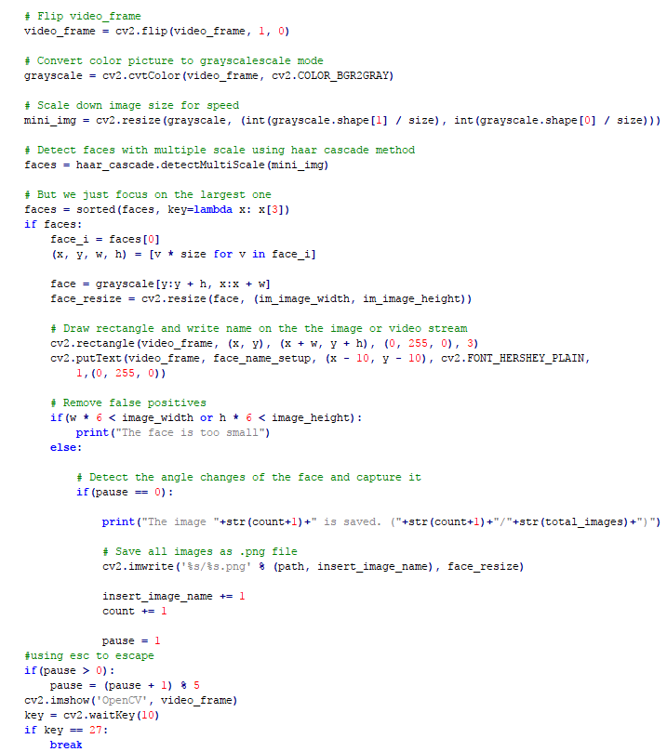
facetraining.py

Slide 11
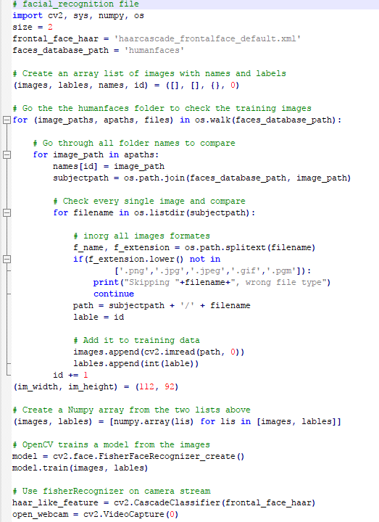
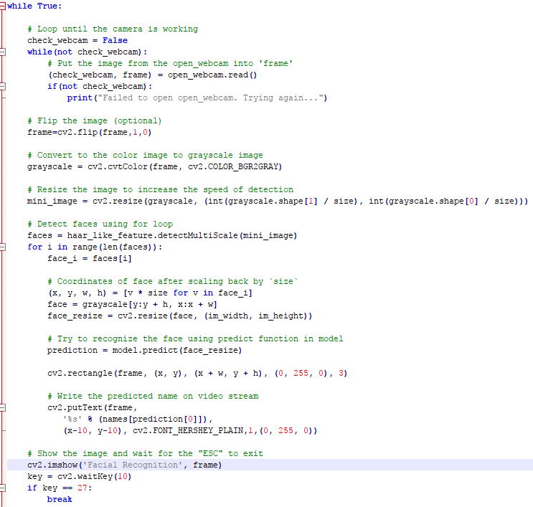
facial_recognition.py

Slide 12
Demo

